Slide 1
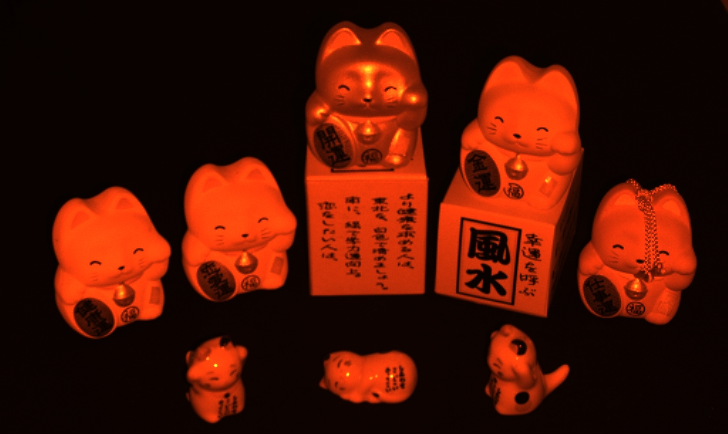

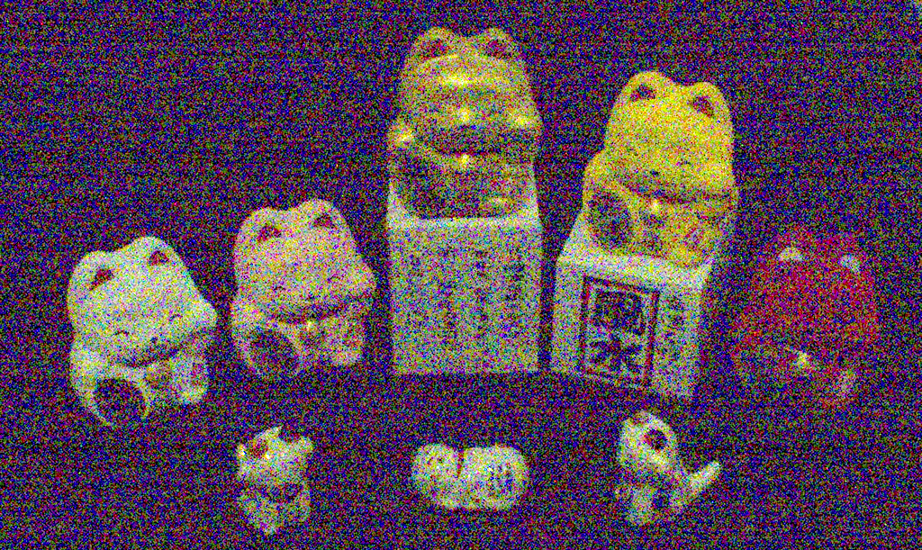





Flash
Seeing in Extra Darkness Using a Deep-Red Flash
No-Flash
Jinhui Xiong*, KAUST
Jian Wang*, Snap Research
Wolfgang Heidrich, KAUST
Shree Nayar, Snap Research
CVPR 2021 (oral)
(* equal contribution)
Output
Notes:
In this work, we present a new flash technique for low-light imaging.

Slide 2
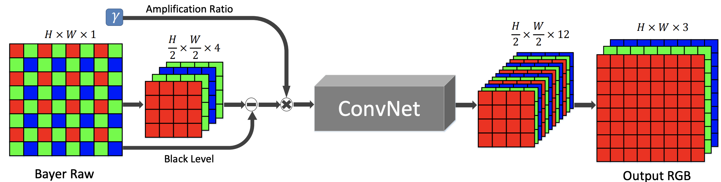
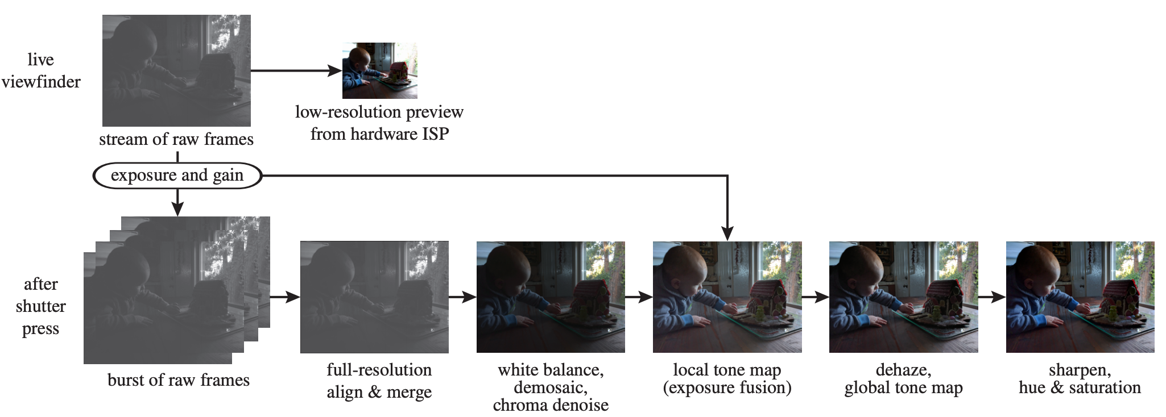
Current Solutions – No Flash
No Flash:
  Burst photography: Multiple images registration and fusion
(Registration is problematic when light is extra dim)
  Deep-learning based low-light imaging
[Hasinoff et al, 2016]
[Chen et al, 2018]
Need adequate illuminance
Notes:
Burst photography is widely adopted for low-light imaging by fusing a burst of noisy images . However, the registration of the images becomes problematic in extra dim conditions.
More recent approaches tackle the low-light imaging problem using modern neural network models and process on the raw sensor data.
These approaches still fail in very dim environments, where the raw data suffers from very poor signal-to-noise ratio. They still need adequate illuminance.

Slide 3
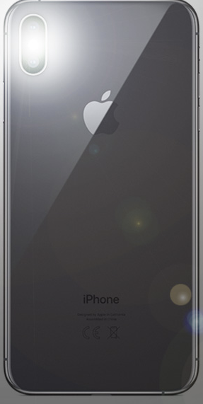
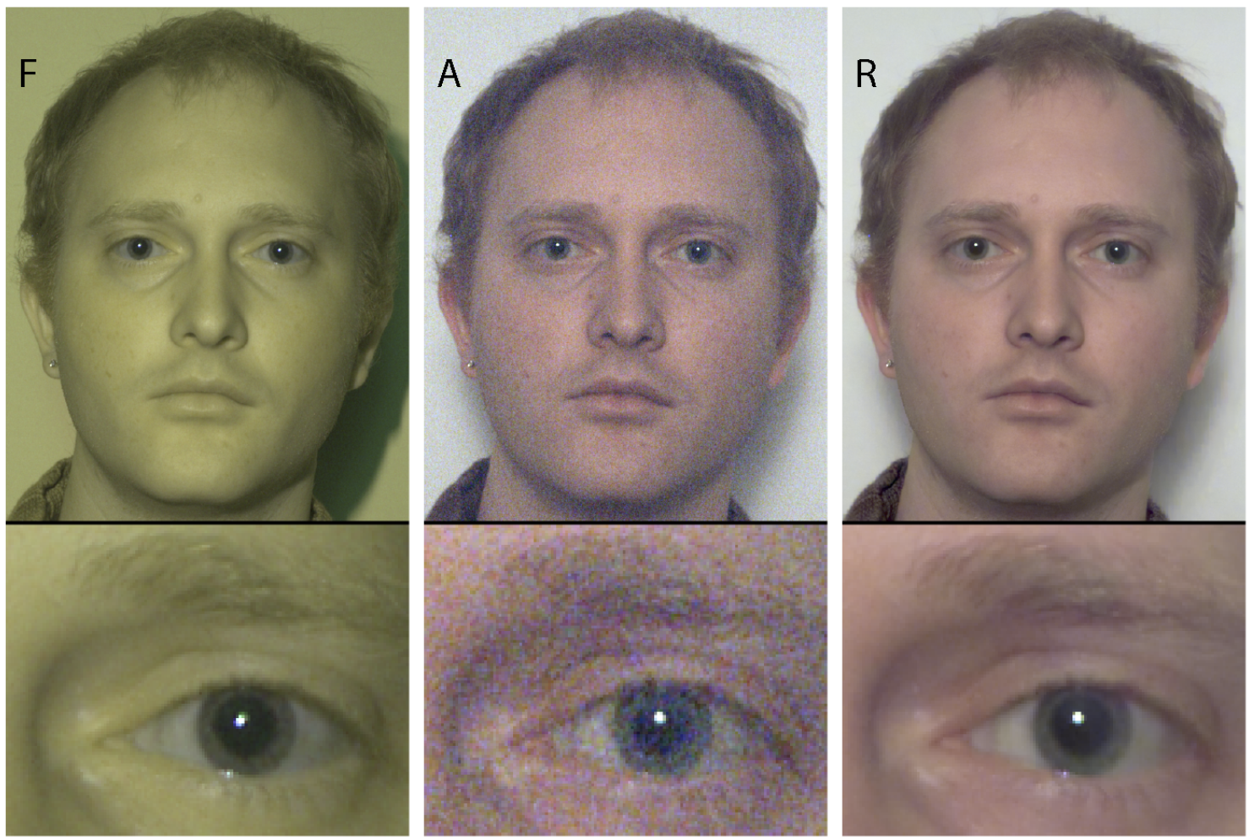
Current Solutions – Flash
Flash:
  White Flash: Unnatural illumination, disturbance
  Invisible Flash (NIR): Additional camera
Social problems
[Krishnan et al, 2009]
Complicated hardware
Source: www.redmondpie.com/
Notes:
Flash photography also has a long history and generally provides the best results. However, white flash dazzles human eyes, and it is not user friendly. Using invisible flashes can avoid this disturbance. However, RGB cameras do not have sensitivity to the invisible spectrum, thus an additional camera for NIR sensing is required.
Using white flash or NIR flash either raises social problems or requires a complicated hardware. Both are not desired.

Slide 4
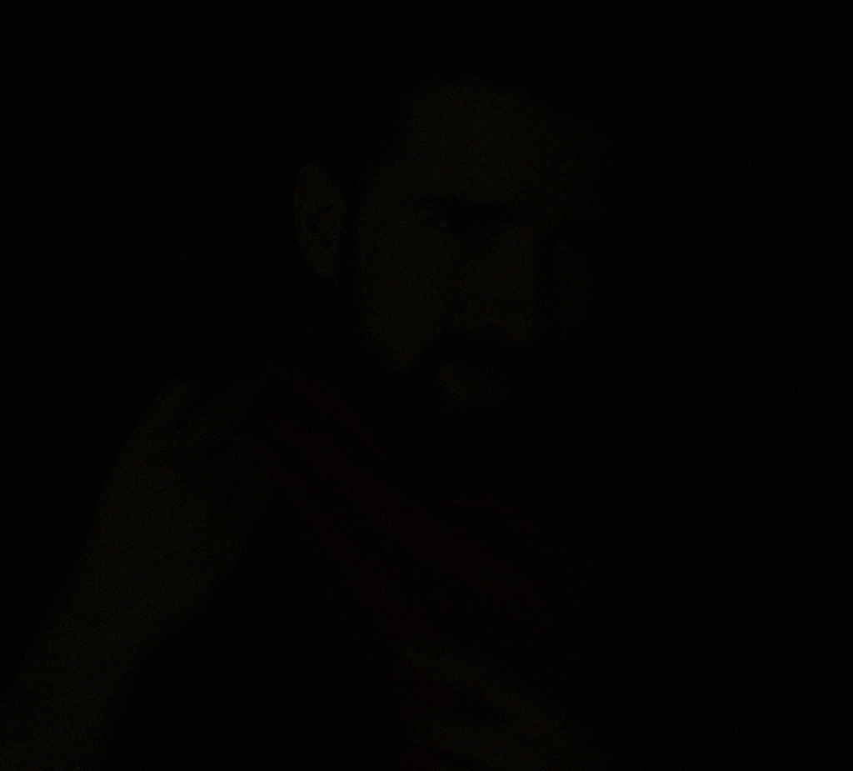

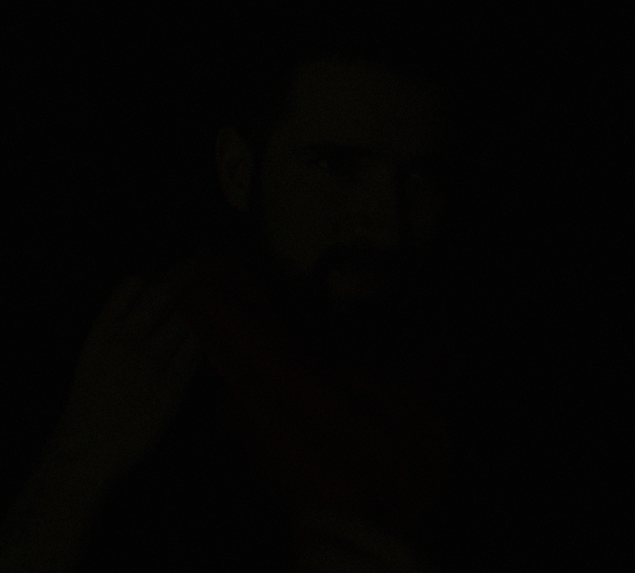
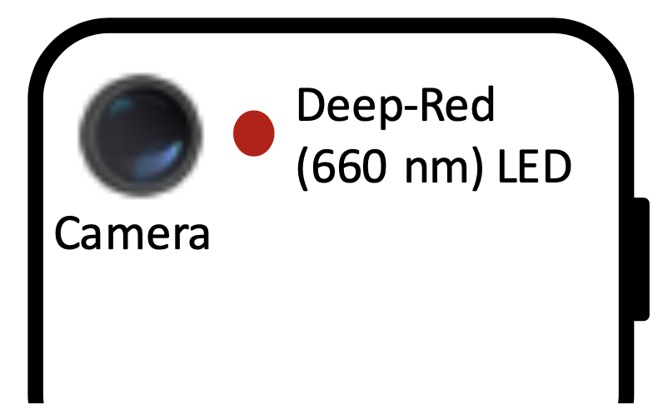

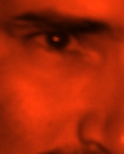


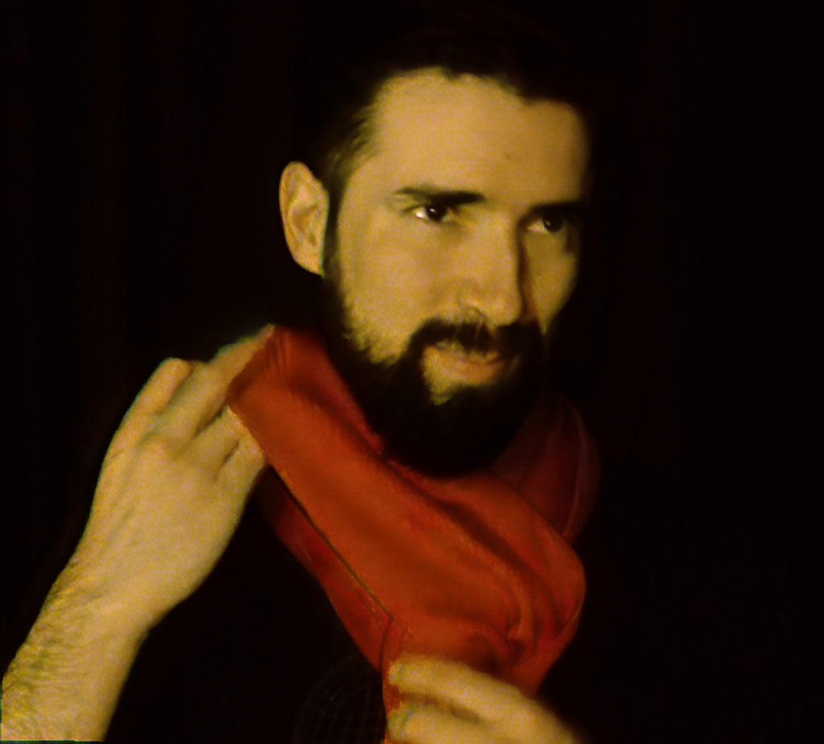



Proposed Solution
Deep-Red Flash
Time
Deep denotes long-wavelength.
Input Stream
Output Stream
Notes:
We propose to use the deep-red light as an illuminating source for low-light imaging. We further extend this flash technique for low-light video reconstruction.

Slide 5
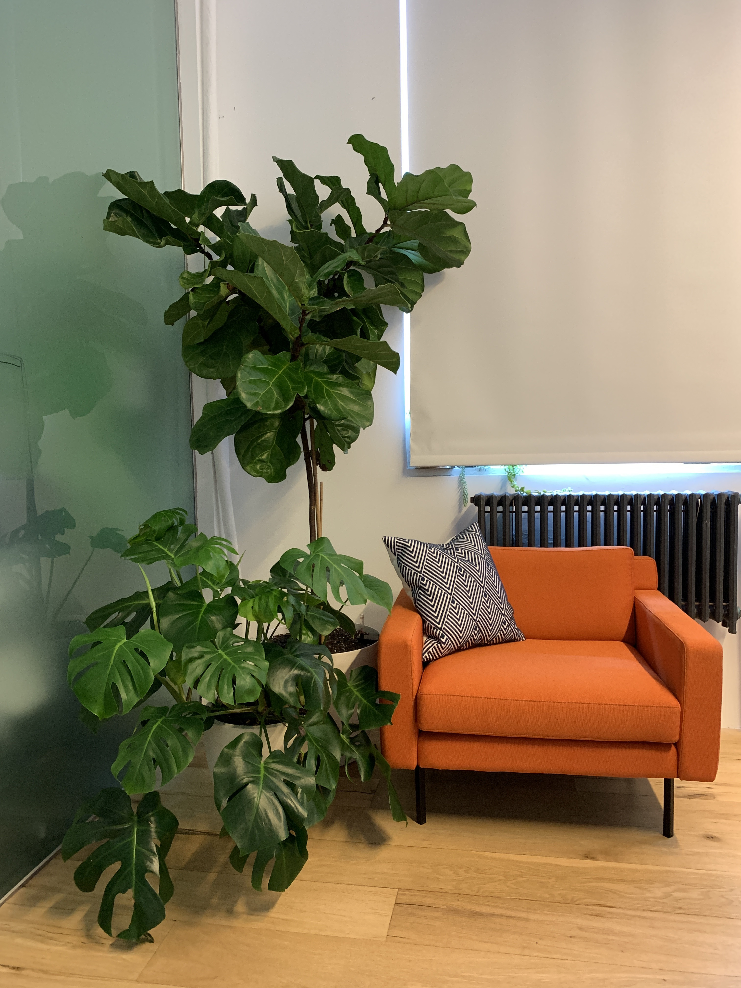
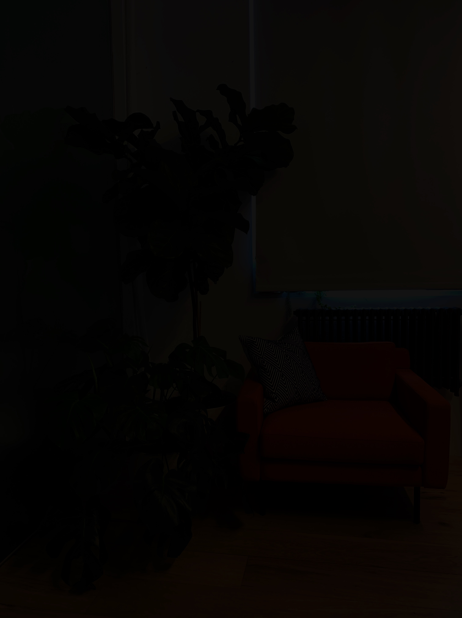
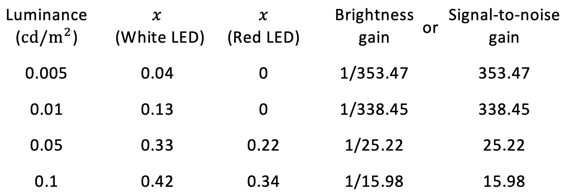
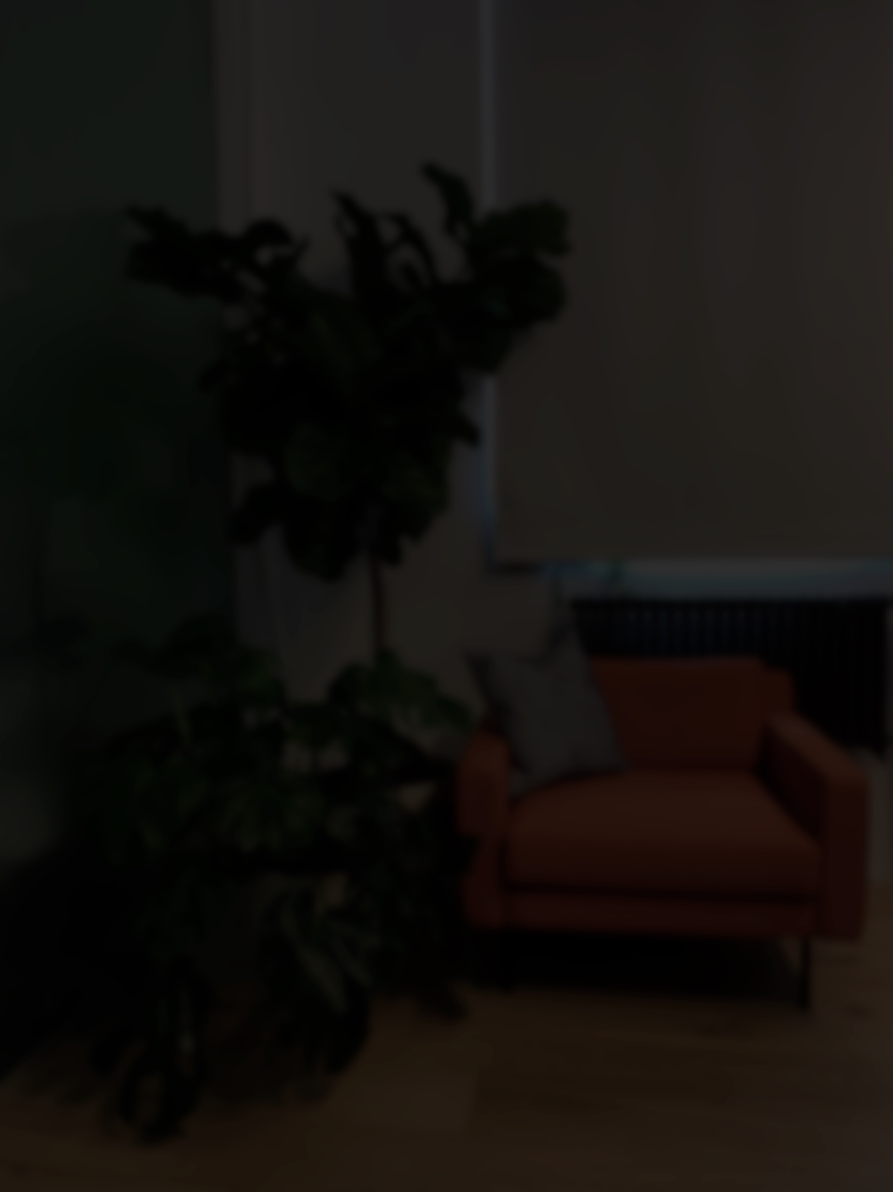
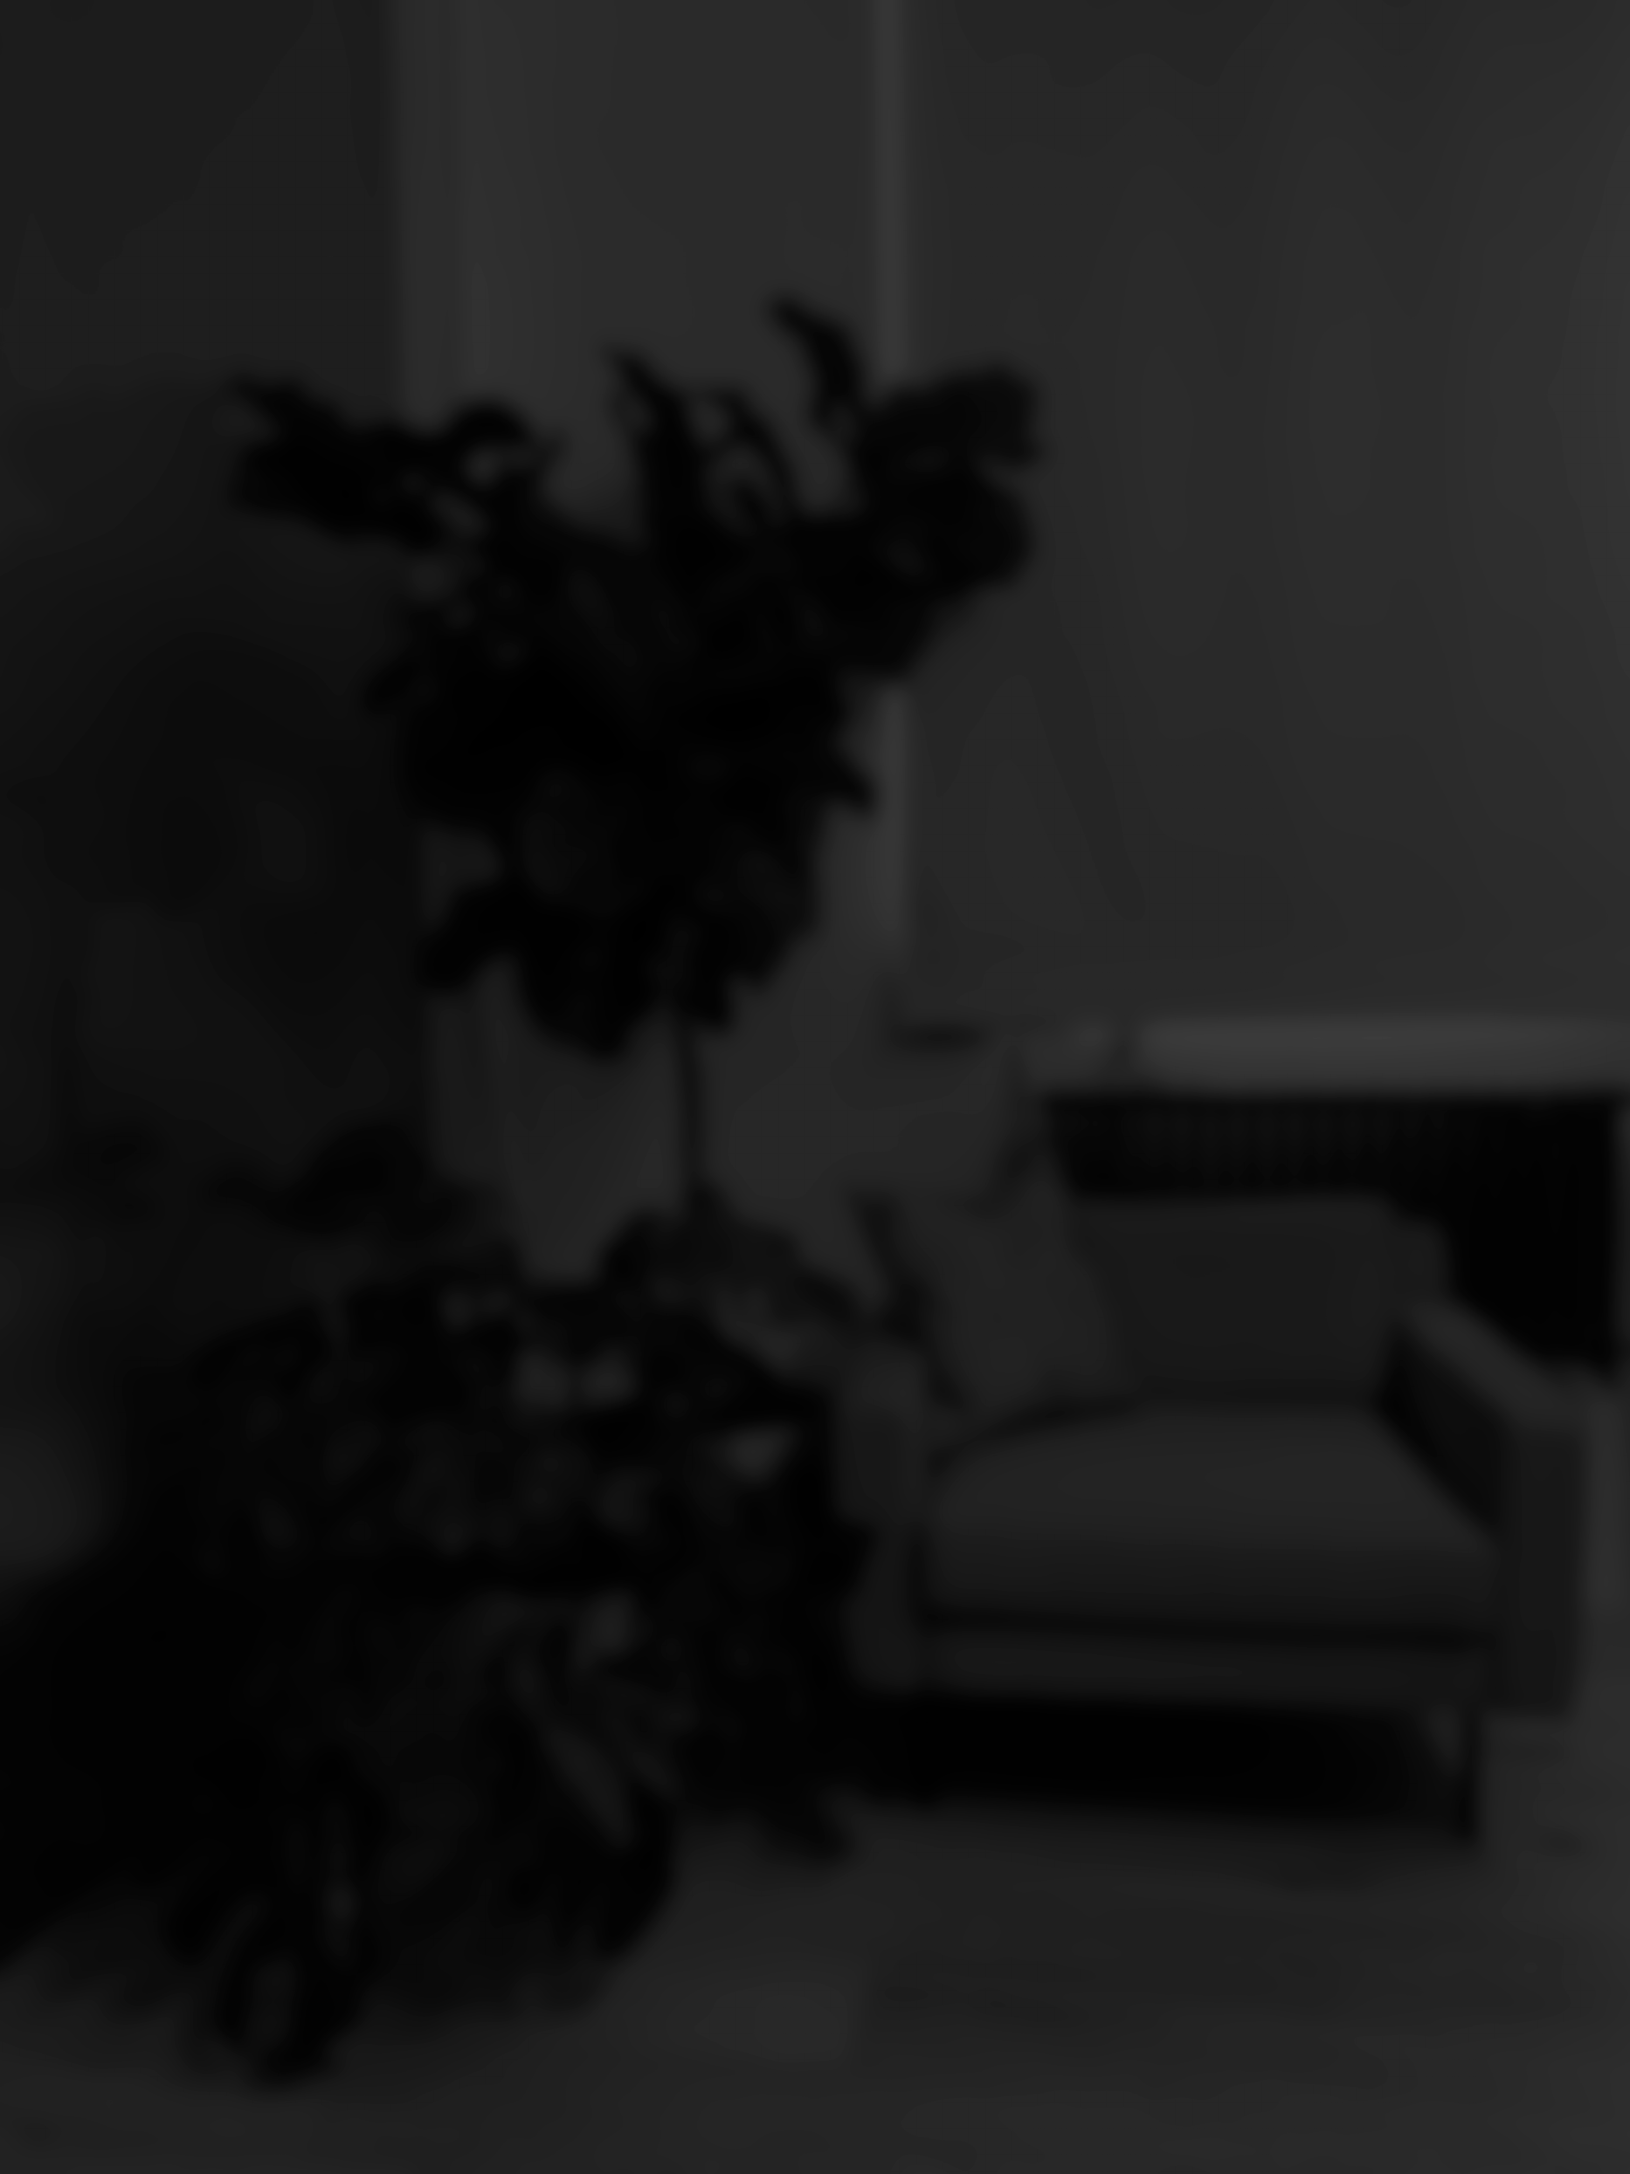
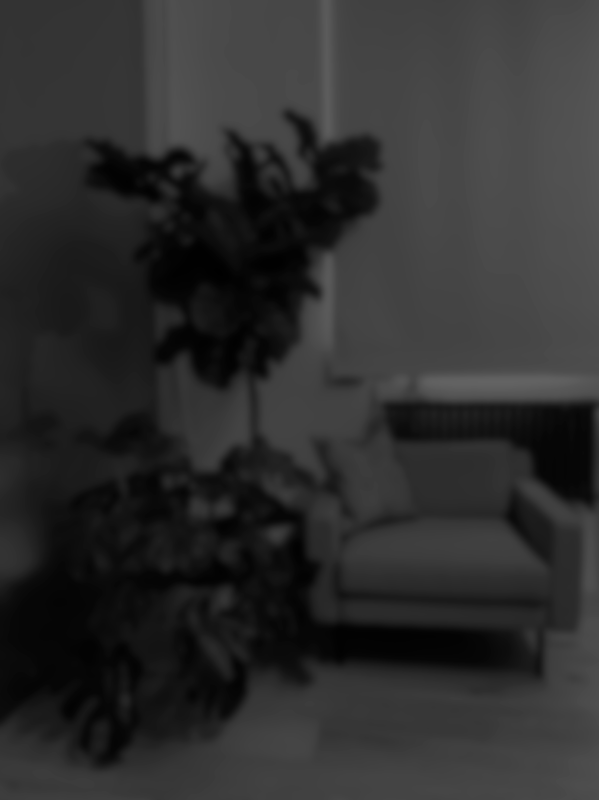



Human Visual System
Scotopic vision $V’(λ)$
Luminosity Function
Mesopic vision $V_{M}(λ)$
Photopic vision $V(λ)$
Light On
Light Off
5 min Later
15 min Later
30 min Later
Perceived Brightness
Dark Adaptation
Notes:
The design of this flash is in the consideration of the human visual system.
The cones and rods are responsible for the perception of light. The cones function in bright-light conditions, referring to photopic vision. The rods become active in dim-light conditions, referring to scotopic vision. A combination of cones and rods forms mesopic vision.
Given the luminosity function of human eye and the spectral power of a white flash and the deep-red flash, we could compute the perceived brightness by human eye. In extra dim conditions, using white flash is over two orders of magnitude brighter than using the red flash as perceived by the human eye when the camera receives the same amount of signals.
Another significant property of human visual system in dim conditions is dark adaptation.
In a brightly lit room, the human visual system has a good sense of color and high spatial acuity. When the light is off, the human eye is temporarily blind. The visual system undergoes a gradual transition from cone vision to rod vision. It achieves night vision with low acuity and nearly no color sense after 30 minutes. When exposed to light like a burst of white flash, the rods immediately photobleach and lose their sensitivity to light, causing flash blindness. Night vision, however, is preserved using deep-red light as long-wavelength lights prevent rods from bleaching.

Slide 6
Low-Light Photography
Image Fusion
Ambient-Light Image
Guide Image
MFF-Net
Mesopic Flash Fusion
Notes:
For red-flash low-light imaging, We trained a neural network, named as mesopic flash fusion network, to fuse the ambient-light image and the guide image. Please see the manuscript for details on the training phase.

Slide 7
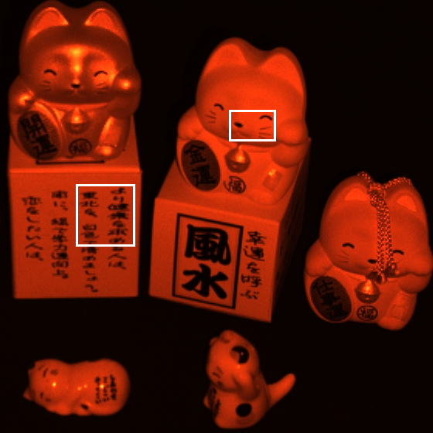
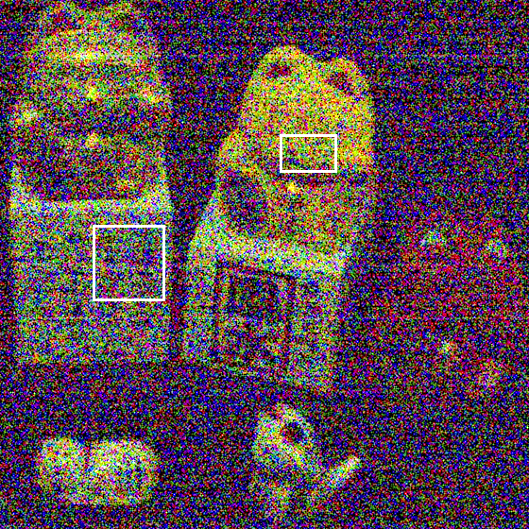
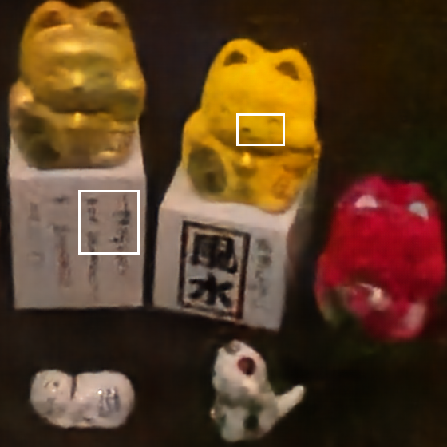
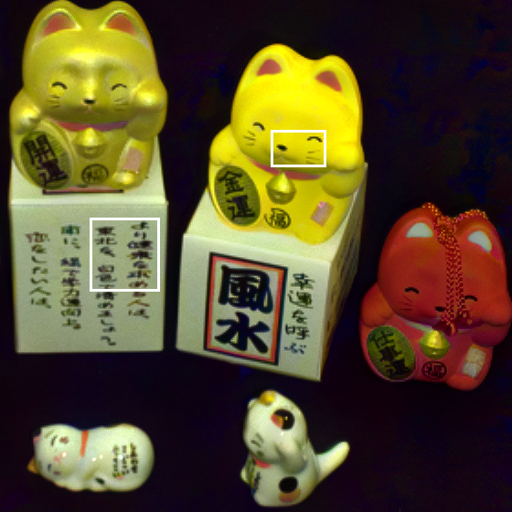








Low-Light Photography
Compared to no-flash methods (real data):
Guide Image
Ambient-Light Image
SID[1]
Ours
Reference
[1] Chen et al. “Learning to See in the Dark.” CVPR, 2018.
Notes:
We compare the proposed flash method against state-of-the-art no-flash approach. The input to the no-flash method is the ambient-light image only. We find that in extra dim environments, which are beyond the capability of no-flash methods, it is essential to use flashes to capture interested scene details.

Slide 8
Low-Light Photography
Compared to other guided filtering methods (real data):
[2] Li et al. “Joint image filtering with deep convolutional networks.” PAMI, 2019.
[3] Shen et al. “Multispectral joint image restoration via optimizing a scale map.” PAMI, 2015.
Notes:
We further compare our reconstruction results to alternative guided image fusion methods. They fail to retrieve fine image details in these rather challenging situations, whereas our method produces clean outputs with fine image features recovered.

Slide 9
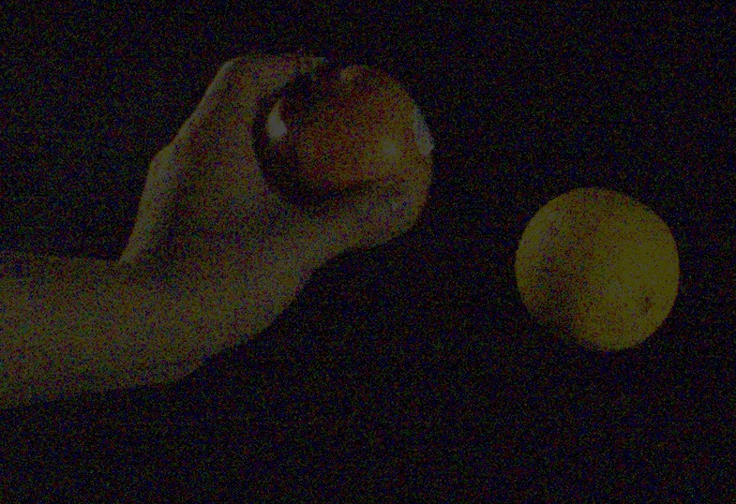
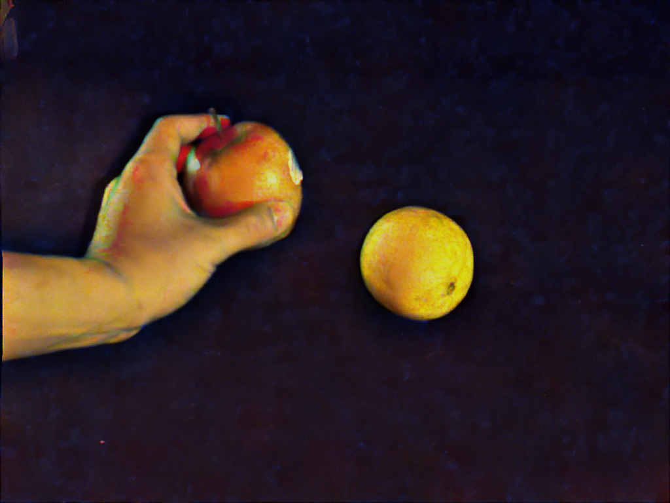
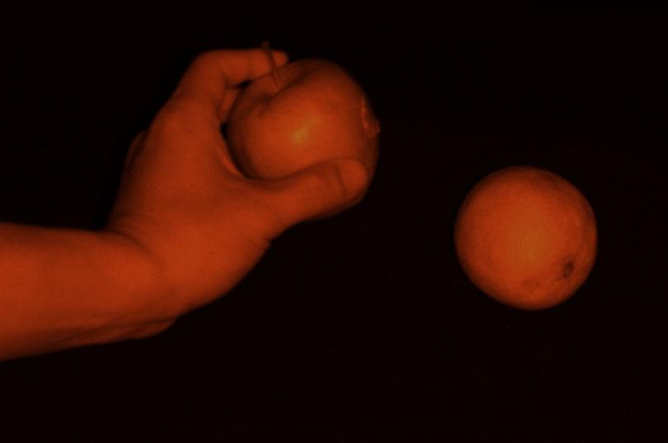
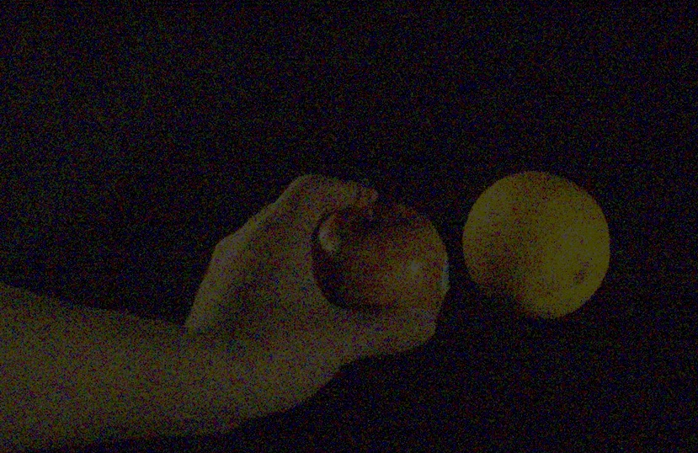
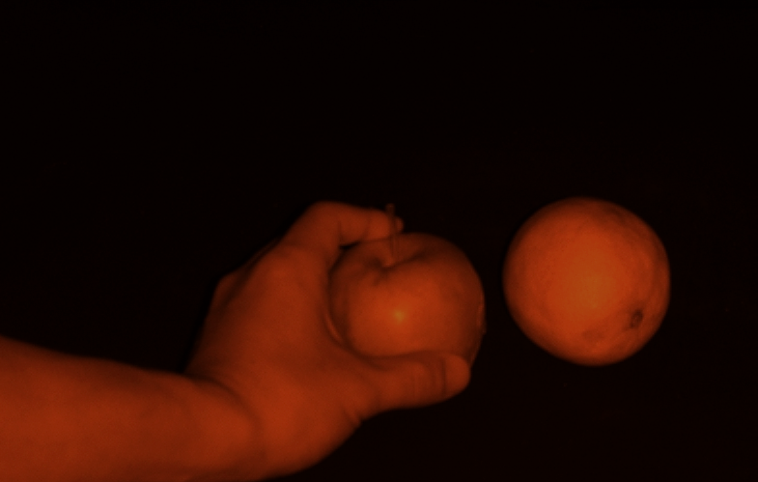
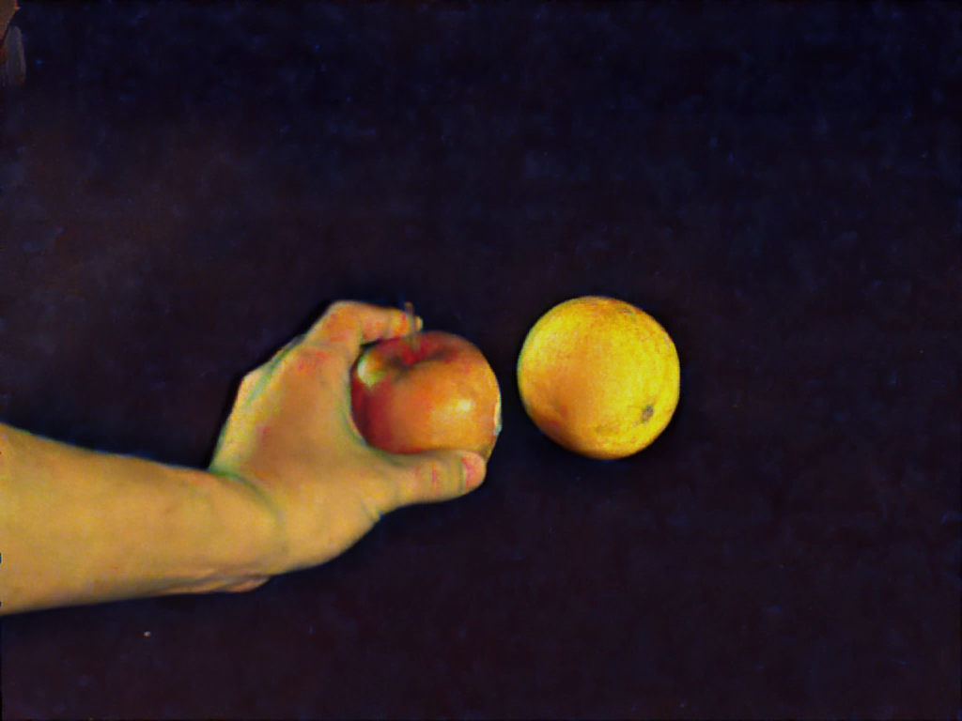
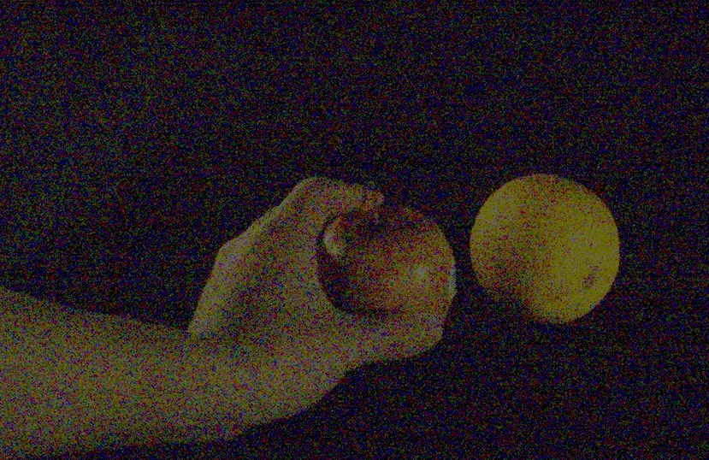

Low-Light Videography
Pipeline
(no frame rate loss)
flow
PWC-Net
MFF-Net
Warp
MFF-Net
TCE-Net
warped
Time
Warp
MFF-Net
TCE-Net
warped
MFF-Net
PWC-Net: Sun et al. “Pwc-net: Cnns for optical flow using pyramid, warping, and cost volume.” CVPR, 2018.
TCE-Net: Lai et al. "Learning blind video temporal consistency." ECCV, 2018.
Notes:
To generalize low-light photography to videography, the input becomes a sequence of flash and no-flash image pairs recorded by the same camera.
We present a pipeline for robust video reconstruction. We first compute the optical flow between two consecutive guide signals. We then forward-warp the flashed frame by one half of the flow field to pair with the no-flash frame, and forward-warp the no-flash frame by the other half of the flow field to pair with the next flashed frame. Such a process ensures a robust alignment in the dark. We then apply Mesopic Flash Fusion Network to each pair and a Temporal Enhancement Network to alleviate flickering artifacts.
Such a pipeline preserves the original frame rate.

Slide 10
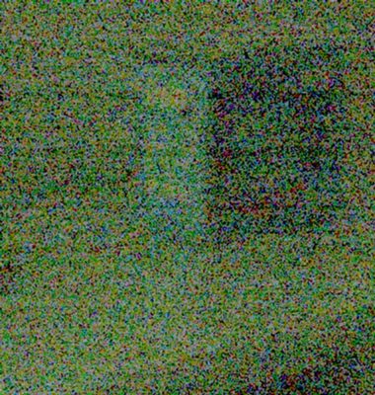
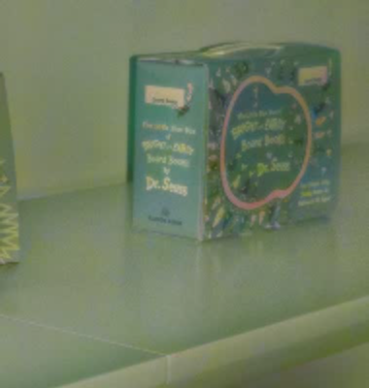
Captured Input Stream (guide frames removed)
Ours (no frame-rate loss)
Notes:
We show the reconstructed videos for dynamics scenes. The left is input video with guide frame removed.

Slide 11
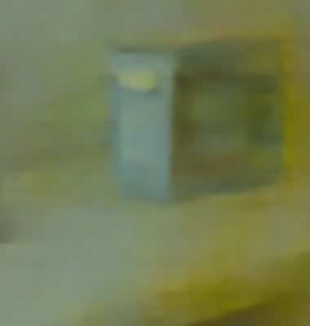
SID motion (half frame-rate, no guide frames)
Ours (no frame-rate loss)
Chen et al. "Seeing Motion in the Dark." ICCV, 2019.
Notes:
We also show the qualitative comparison with no-flash video reconstruction method. Like no-flash photography, state-of-the-art no-flash video denoising approaches cannot recover sufficient image details when the camera sensor captures poor signals.

Slide 12
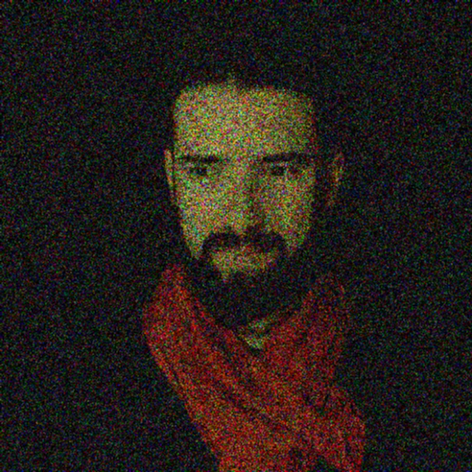
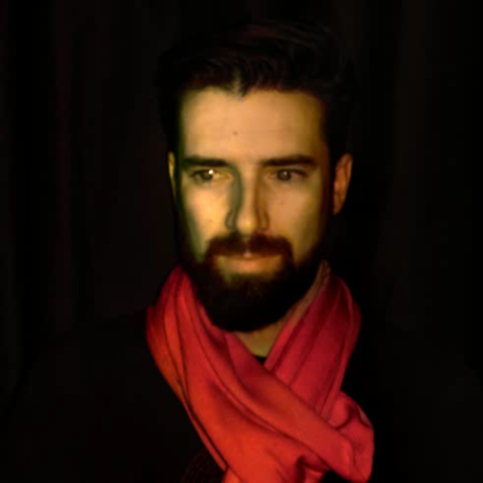
Captured Input Stream (guide frames removed)
Ours (no frame-rate loss)
Notes:
We also show a scene with human motions.

Slide 13

Thanks for your watching!
Our code and dataset are available at:
https://github.com/vccimaging/Deep-Red-Flash
Notes:
Thanks for your watching. The code and data are made available.

